Slide 1
AFRICAN FILM & LIT, WEEK II, LESSON I - ON FILM ANALYSIS & YEELEN (1987)
Tools and Text.

Slide 2
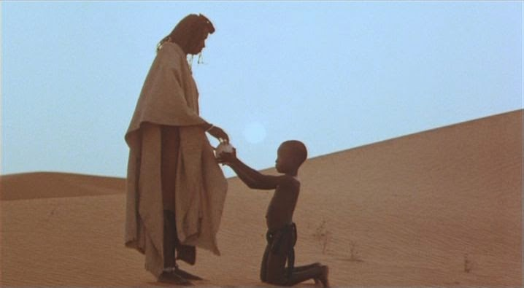
Fig. a. Still from Yeelen (1987) dir. Souleymane Cissé

Slide 3
So, how do we analyse films?

Slide 4
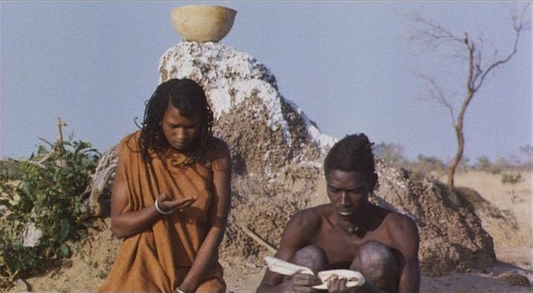
Fig. b. Still from Yeelen (1987) dir. Souleymane Cissé

Slide 5
Basic Elements of Film Analysis

Slide 6
Film analysis is not unlike other textual analysis.
It draws upon the same skills. We can broadly understand or define these skills as close reading.
But what are we reading/watching a film for?
Around which ideas or features of film do we base our readings?
The following are a few of some such areas and features.

Slide 7
Film Contents
Film Facts
Title of film
Year film was produced
Nationality
Names of the performers
Name of director
What is a Film Made of?

Slide 8
Genre & Setting
What main genre does the film fall under? – romantic, historical, detective, thriller, adventure, horror, and science fiction.
What sub-grouping does the film fall under? – action, comedy, tragedy, war and westerns.
Physical Setting is a description of where and when the story takes place.
Temporal Setting: Does it take place in the present, the past, or the future?
What aspects of setting are we made aware of? – Geography, weather conditions, physical environment, time of day.
Where are we in the opening scene? Final scene? Any parallels

Slide 9
Plot & Structure
What are the most important sequences?
How is the plot structured?
Is it linear, chronological or is it presented through flashbacks??
Are there several plots running parallel or counter to one another?
How is suspense built up?
Do any events foreshadow what is to come?

Slide 10
Examples
Tenet-Airport Scene: Simultaneously forward and reverse progression
500 Days of Summer - Expectations vs Reality, the narrative structure splits and runs parallel with itself
Eternal Sunshine of the Spotless Mind - Erasing memories first, then the rest of the film is an exploration of how those memories were formed in the first place

Slide 11
Conflict Characterization
How would you describe the main conflict?
Is it internal where the character suffers inwardly?
is it external caused by the surroundings or environment the main character finds himself/herself in?
Characterization deals with how the characters are described.
through dialogue?
by the way they speak?
physical appearance? thoughts and feelings?
interaction – the way they act towards other characters?
Are they static characters who do not change?
Do they develop by the end of the story?
What type of characters are they?
What qualities stand out?
Are they stereotypes?
Are the characters believable?

Slide 12
Narrator and point of view (P.O.V)
The narrator is the person telling the story.
Is there a narrator in the film? Who?
Point of view means through whose eyes the story is being told.
Through whose eyes does the story unfold?
Is the story told in the first person “I” point of view?
Is the story told through an off-screen narrator?

Slide 13
Imagery
In films imagery are the elements used to create pictures in our minds. They may include:
Symbols – when something stands not only for itself ( a literal meaning), but also stands for something else (a figurative meaning) e.g. The feather in the film Forrest Gump symbolizes his destiny.
What images are used in the film? e.g. color, objects etc.
Can you find any symbols?

Slide 14
Theme
What are the universal ideas that shine through in the film (in other words, what is it about, in general)?

Slide 15
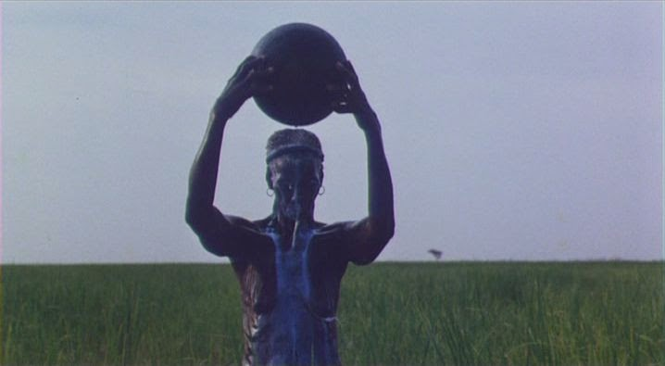
Fig. c. Still from Yeelen (1987) dir. Souleymane Cissé

Slide 16
Cinematic Effects: Closer Features of Films

Slide 17
Soundtrack
includes both dialogue and music, as well as all the other sounds in a film.
enhances the atmosphere of the film (what effect does the choice of music have? Does it suit the theme?)
Are any particular sounds accentuated?
Features of Aurality

Slide 18
Use of Camera
A camera shot is based on the camera’s distance from the object.
The four basic shots used in films are:
a close-up – a very close shot where the camera lens focuses on some detail or the actor’s face.
medium shot – a shot where the camera lens picks up some background or upper half of the actor.
full shot – a shot where the camera lens has full view of the actor.
long shot – shot taken at a distance from an object.
Capturing Motion

Slide 19
Use of Camera Continued
What camera shots can you identify in the film? How are they used?
A camera angle is how the camera is tilted while filming.
straight-on angle – The camera is at the same height as the object.
high angle – The camera is filming from above the object.
low angle – The camera is looking up at the object.
oblique angle – The camera is tilted sideways.
Does the way in which the camera is held say anything about the character?
Capturing Movement

Slide 20
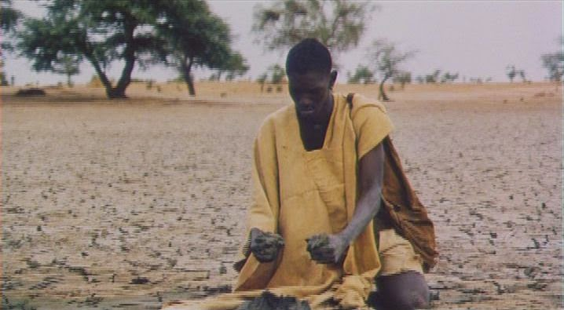
Fig. d. Still from Yeelen (1987) dir. Souleymane Cissé

Slide 21
Lighting
Lighting focuses the audience’s attention on the main character or object in a film.
It also sets the mood or atmosphere.
While high-key lighting is bright and illuminating, low-key lighting is darker with a lot of shadows.
What special lighting effects are used during the most important scenes?
Filters are often used to soften and reduce harsh contrasts. They can also be used to eliminate haze, ultraviolet light or glare from water when shooting outside.
Light and Shadow, Seen and Unseen

Slide 22
Examples
The Fall - Sumptuous lighting separates the real from the cinematic, the story world and the real world.
Little Miss Sunshine - Even in a night scene like this, the film maintains high key lighting
Dark City - Low key lighting, noirish, very dark, atmosphere of despair, confusion, danger

Slide 23
Lighting Cont.
Using color like red or orange can be used to enhance the feeling of a sunset. But also, could signpost ideas or feelings associated with rage and violence.
Can you find any examples where a filter has been used in the film?
What effect did using a filter have on the scene?
What colors are most dominant?
Light, Shadow, Seen & Unseen

Slide 24
Editing
Editing is the way in which a film editor together with the director cuts and assembles the scenes. The way the scenes are joined together creates the rhythm of the motion picture. Scenes can be long and drawn out or short and choppy.
Can you see a pattern to how the scenes are cut?
How would you describe the pace/tempo of the film?
Speed and Duration

Slide 25
Examples
Victoria - Improvised dialogue, entire film is one unbroken (though sometimes spliced) shot. Other notable examples include Russian Ark and Birdman. In this case, there is little to no editing at all. The scenes and film play out in real time, in this case, over the period of a night and a morning. This slows down the narrative.
Whiplash - Large number of cuts, creates a sense of tempo, speed, intensity, movement, kinetics, tension. Unlike in Victoria, the tension can be manipulated and experienced in accelerated and decelerated ways.

Slide 26
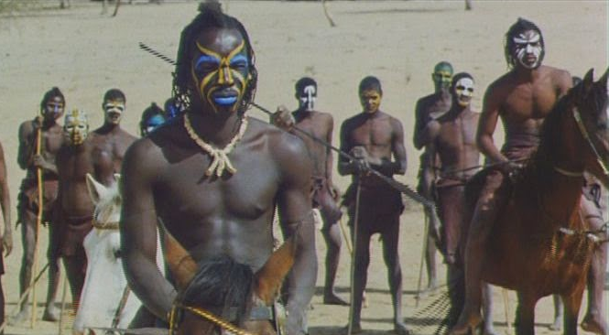
Fig. e. Still from Yeelen (1987) dir. Souleymane Cissé

Slide 27
Practice.
You will be split into 3 groups.
We will then all watch 3 short clips from Malcolm X, SLAM!, and Atlanta.
Each group will have 15 minutes to discuss the clips.
We will then take 25 minutes - that’s 5 minutes per group - to offer some remarks using the terminology and concepts we’ve just learned: e.g Conflict, Imagery, Characterization, Genre, Editing, Lighting, Camera Use, Sound etc.
CLIP I: Dictionary Scene - Malcolm X (Dir. Spike Lee, 1992)
CLIP II:
Young White Avatar - Atlanta (Dir. Hiro Murai)
CLIP III:
Amethyst Rock - SLAM! (Dir. Marc Levin)

Slide 28
5 Scenes, 5 Groups
You will be split into 5 groups.
We will then all watch 5 short clips from Yeelen.
Each group will have 15 minutes to discuss the clip assigned to them.
We will then take 25 minutes - that’s 5 minutes per group - to offer some remarks concerning the following elements as they appear in the 5 scenes: Editing, Lighting, Camera Use, and Sound
Close Reading Film

Slide 29
Scenes: I) Timestamp: 12:17-15:03 II) Timestamp: 15:55-17:50 III) Timestamp: 28:06-31:35
IV) Timestamp: 41:22-43:27 V) 1:17:02-1:19:13

